Slide 1

Legacy data
Evaluation for its application in DSM
Luis Rodriguez Lado - GSP

Slide 2
Agenda
What is Legacy Soil Data?
Evaluation of Legacy Soil Data for DSM
Spatial representativeness of LSD
Kullback–Leibler (KL) divergence
Convex-Hull on PCA
Acknowledgements
References

Slide 3
What is Legacy Soil Data?
Legacy Soil Data (LSD):
"Legacy Soil Data" refers to historical or existing soil data that have been collected in the past for various purposes, such as soil surveys, research projects, or agricultural assessments.
These data are typically collected before the implementation of modern digital soil mapping techniques.
LSD can include information about soil properties, composition, texture, depth, etc., gathered through field observations and posterior laboratory analyses. It also includes available soil maps in analogic formats.
In DSM, legacy soil data are often used to supplement or enhance current soil mapping efforts. The quality and representativeness of legacy data should be evaluated to determine their suitability for integration into DSM.

Slide 4
Evaluation of Legacy Soil Data for DSM
Adequacy: Do the legacy data cover the same parameters required for your DSM model?
Data Quality Assessment: Check for errors, inconsistencies, missing values, and outliers.
Spatial Distribution: Analyze the spatial distribution of the legacy soil data points.
Are they evenly distributed across the study area?
Do they cluster in certain regions?
Representativeness: how well existing LSD capture the true spatial variation and characteristics of soils in the area?

Slide 5
Spatial representativeness of LSD
How well existing LDS capture the true spatial variation and characteristics of soils in the area?
Soils properties are related to the environmental characteristics, defined as raster layers.
Characterize the environmental variability in the area.
Identify the environmental variability at LSD points.
Compare the probability distribution of the population (P) and the probability distribution of the samples (Q) variabilities through similarity metrics (Kullback–Leibler divergence)
Determine in which extent P can be explained by Q.
Evaluate the degree in which the dataset represents the study area.
Decide if new samples should be collected.

Slide 6
Kullback–Leibler divergence
KL-divergence
"KL divergence" is a way to measure how different two probability distributions are from each other.
Compares probability distributions of population (P) vs samples (Q).
P represents the "true" or "real" distribution of environmental variability
Q represents an “approximation” of P using a sample set.
KL divergence indicates how much information is lost when using Q to approximate P.
If P and Q are exactly the same, KL divergence = 0, samples capture all the information in the area.
Generally P and Q are different, KL divergence > 0, there's a difference between the two distributions.
The smaller the KL divergence, the closer Q is to P, and the better the approximation.
The larger the KL divergence, the more Q differs from P.
KL(Q||P) = Σ(Q(x) * log(Q(x) / P(x)))
Σ represents the sum over all possible values of x.
Q(x) is the probability (or density) of x in distribution Q.
P(x) is the probability (or density) of x in distribution P.

Slide 7
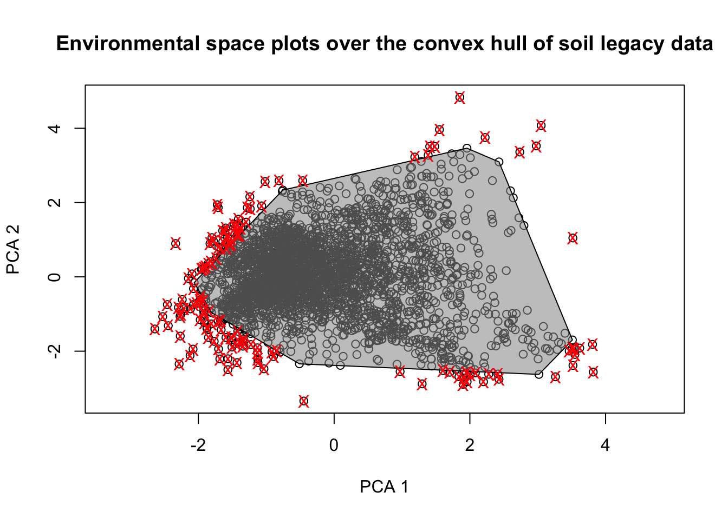
Similarity of P and Q
Representativeness
To assess the extent to which our legacy soil dataset represents the existing environmental conditions in the study area.
Q covariates are transformed to PC components and Q scores are plotted on the main PC space
A convex hull is defined upon the outer points of the PC1-PC2 space
PC scores for P are calculated and plotted on the PC1-PC2 space
The representativeness (%) is calculated by the proportion of PC1-PC2 scores of P that fall within the convex-hull of Q main scores. This value is indicative of the similarity of P and Q.

Slide 8
Case study
Training material in ‘Nghe’ Province (Vietnam)
68 environmental parameters (Available at as GEE assets)
Shapes of province boundaries, rivers, roads and legacy data.
R packages:
terra

Slide 9
Case study
Contents in the exercise:
Data Preparation (terra)
Representativeness of the Legacy Soil Data

Slide 10
Acknowledgments
We want to acknowledge the following authors for the distribution of the R scripts/data included partially in this manual.
@Malone et al
@Saurette et al
Vietnam

Slide 11
References
Goodbody, T.R., Coops, N.C. & Queinnec, M. 2023. Structurally guided sampling. (also available at https://cran.r-project.org/package=sgsR).
Roudier, P., Brugnard, C., Beaudette, D., Louis, B., Daust, K. & Clifford, D. 2011. Clhs: A r package for conditioned latin hypercube sampling. (also available at https://cran.r-project.org/web/packages/clhs/).
Malone, B.P., Minansy, B. & Brungard, C. 2019. Some methods to improve the utility of conditioned latin hypercube sampling. PeerJ, 7: e6451. https://doi.org/10.7717/peerj.6451
Saurette, D. , Biswas, A., Heck, R.J., Gillespie, A.W., Berg, A.A. 2022. Determining minimum sample size for the conditioned Latin hypercube sampling algorithm, Pedosphere.
Saurette, D. , Heck, R.J., Gillespie, A.W., Berg, A.A., Biswas, A. 2022. Divergence metrics for determining optimal training sample size in digital soil mapping, Geoderma, 436.

Slide 12
Index of the script
0 - Set working directory and load packages
1 - User-defined variables
2 - Prepare data
3 - Extract environmental data from rasters at soil locations
4 - Compute variability matrix in covariates
5 - Calculate hypercube of "covariates" distribution (P)
6 - Calculate hypercube of "sample" distribution (Q)
7 - Calculate Representativeness of the Legacy Dataset

Slide 13
Contact Information
luis.rodriguezlado@fao.org
marcos.angelini@fao.org

